Slide 1
REFRESH-ABLE BRAILLE DISPLAY
TEAM Codators:
Eshwar h s
Kethan m v
Vaibhav k t

Slide 2
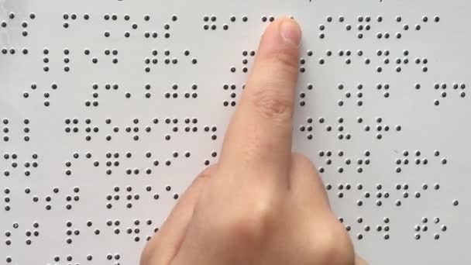
Braille:
It is a tactile writing system used by people who are visually impaired .
Each character is displayed by using 6 braille dots , combination of which represents a particular character .
The characters represented are a-z, A-Z, 0-9 and punctuations.

Slide 3
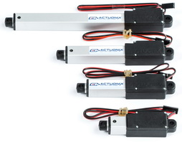
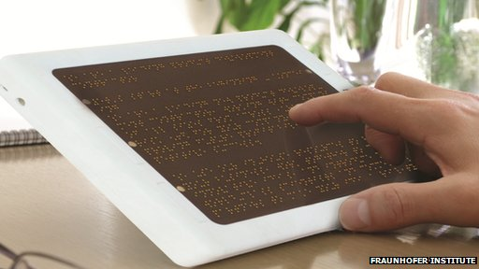
India has the highest visually impaired population among the world.
The average speed of a reader is 25-30 characters per minute. Using our mechanism this speed can be easily accelerated to 45-50 characters per minute.
Every braille book needs metallic sheets with printed dots. These are not cost efficient.
Each Braille e-reader costs about $3000 and is in the fund raising stage .
With the use of linear actuators this cost can be put down to $200.

Slide 4
